Slide 1
Branch prediction corelating on data values
Nivedita Gaur
Bibin George

Slide 2
Why?
Reduce branch mispredictions by remembering where the main branch predictor (from now on called the backing predictor) mispredicts.
Useful in cases like the mispredictions at the end of a for loop where a classic gshare would fail

Slide 3
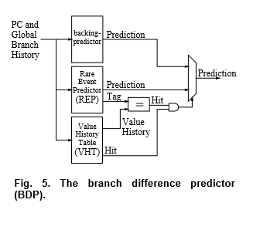
How?

Slide 4
The backing predictor
This is just an ordinary gshare predictor which is not trained when there is a hit in the REP

Slide 5
The Rare Event Predictor
This is a cache like predictor only used to predict the exceptional cases
Replacement policy – get rid of redundant predictions using the counter which tracks the number of corrective predictions

